Slide 1

K18X001.00 Strain Gauge Testing
Report
VN-JBD-ME
05/08/2022

Slide 2
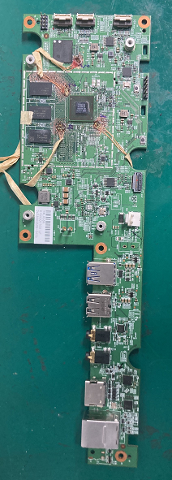
K18X001.00 strain gauge report
Strain gage testing stations :
PCBA Trolley
BT Test
FFC Cable Assembly
Screw PCBA & Heatsink
Srew Housing
Verify Process:
+ Step 1 : At PCBA Trolley
+ Step 2 : At test BT
+ Step 3 : FFC Cable Assembly
+ Step 4 : Screw PCBA &Heatsink
+ Step 5 : Screw Housing
U1 (BGA)
Sensor 1
Experiment Location:
Sensor2
Station | PCBA Assembly
Sensor Q’ty | 2
Location Test | U1 (BGA)
PCBA Test sample

Slide 3
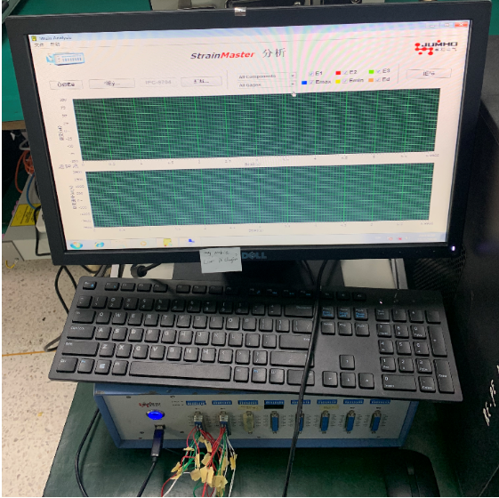
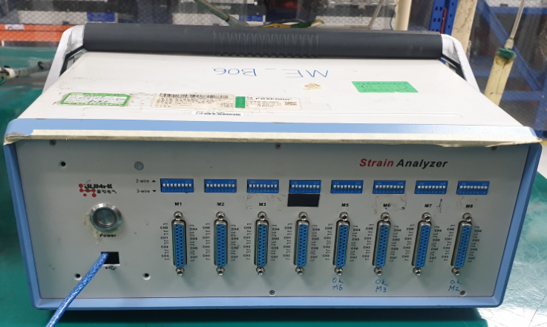
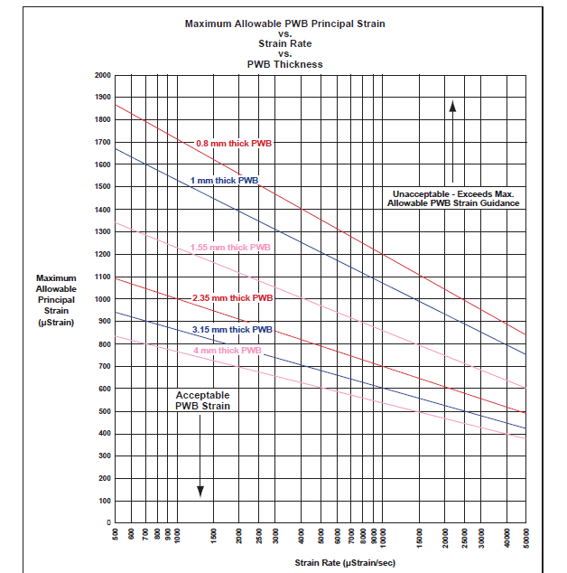
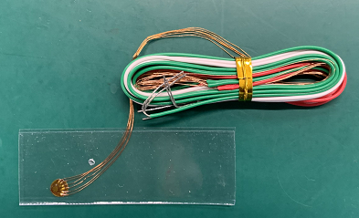
K18X001.00 strain gauge report
Strain Gage Parameters:
Test Date-Time:05/08/2022
Hardware Type : cDAQ
Board Thickness(mm):1.6mm
Gage FACTOR:2.1
Gage TYPE: One axis
Nominal Resistance： 120.00 Ohm
Strain gauge
The thickness of RGW PCB
Test data
Sensor
Fig 1
Criteria Limit :
Following the data strain standard, conduct inspections of high-risk operations of PCBA was affected by strain gauge.
(Standard strain gauge value in the range: -400~400 uE.)

Slide 4
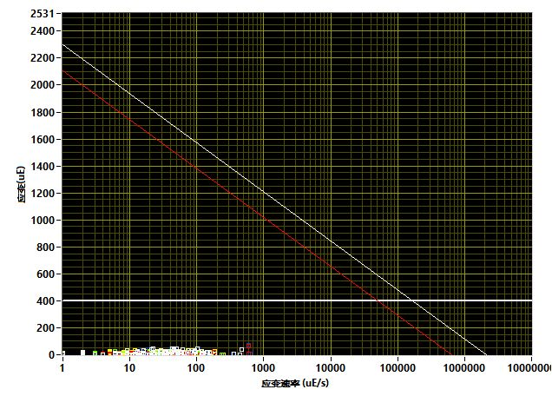
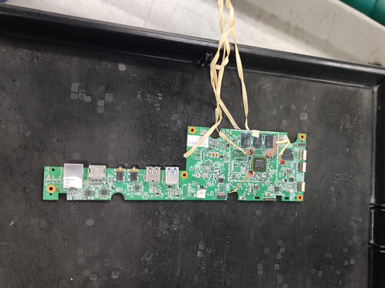
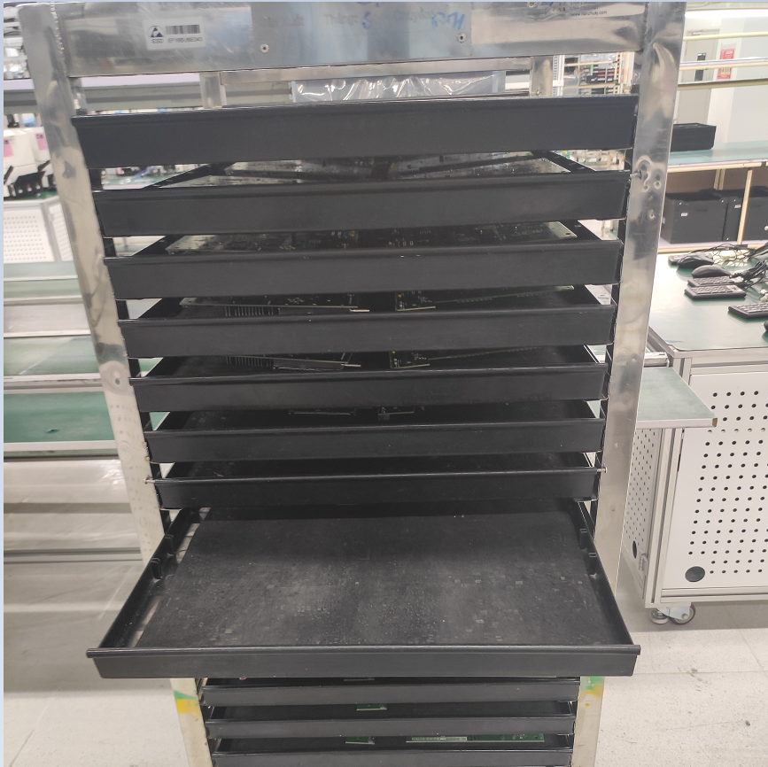
Station : PCBA Trolley
Step 1 : At PCBA Trolley
TRAY Trolley
Max Diagonal Value(uE):
IPC9704表格
编号 | 元件名 | 位置 | 应变最大值(uE) | Limit (uE) | 结果
No.1 | SENSOR 2 | U1 | -7 | 400 | Pass
No.2 | SENSOR 1 | U1 | 70 | 400 | Pass
Result: Measured values are within the standard of control-> PASS

Slide 5
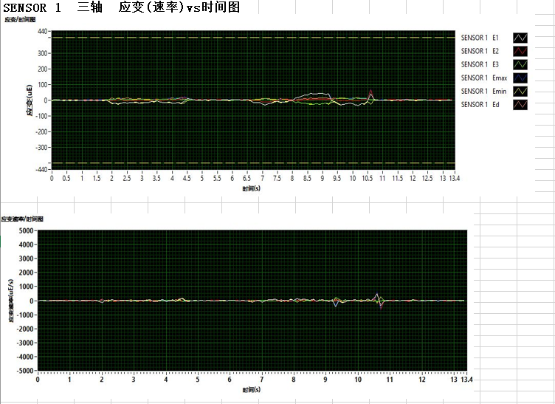
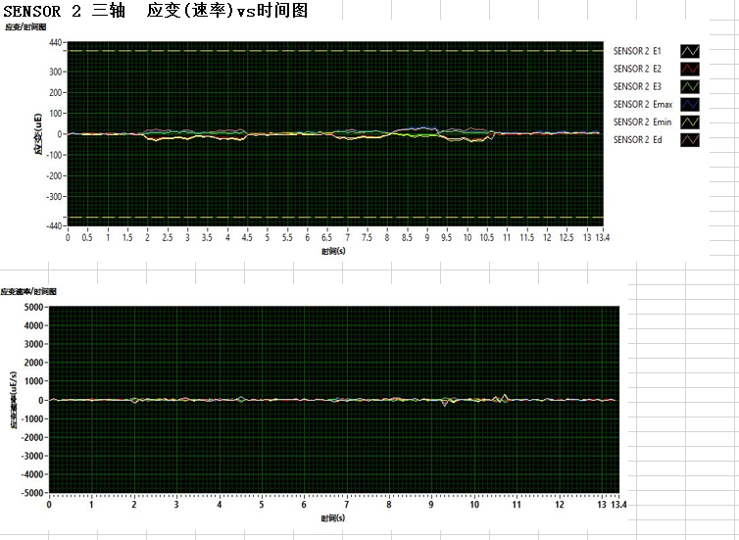
Station : PCBA Trolley
Type 1 : At PCBA Trolley
Image Sensor 1
Image Sensor 2

Slide 6
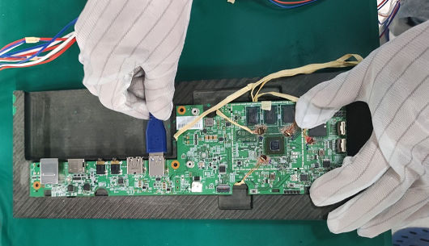
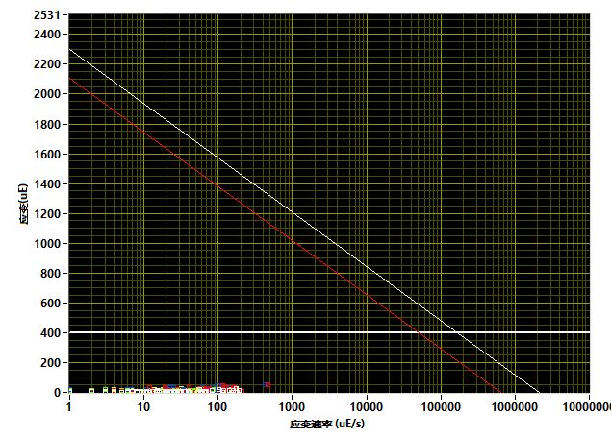
Station : Test BT Station
Type 2 : At test BT station
Max Diagonal Value(uE):
IPC9704表格
编号 | 元件名 | 位置 | 应变最大值(uE) | Limit (uE) | 结果
No.1 | SENSOR 2 | U1 | -35 | 400 | Pass
No.2 | SENSOR 1 | U1 | 51 | 400 | Pass
Result: Measured values are within the standard of control-> PASS

Slide 7
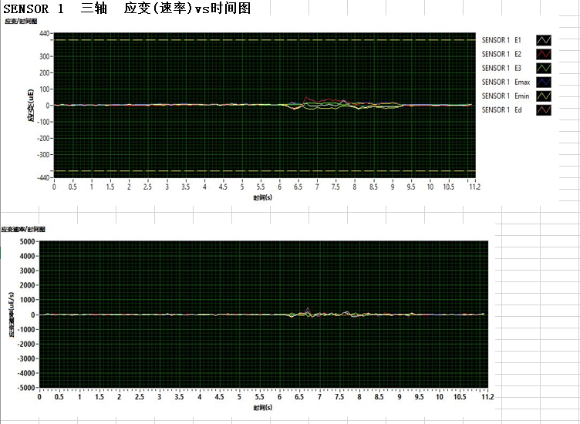
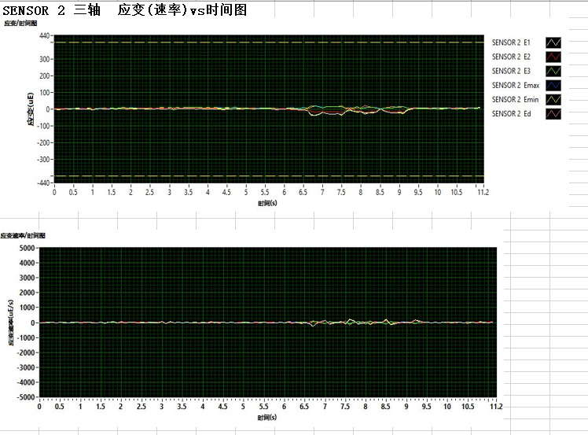
Station : Test BT
Type 2 : At test BT station
Image Sensor 1
Image Sensor 2

Slide 8
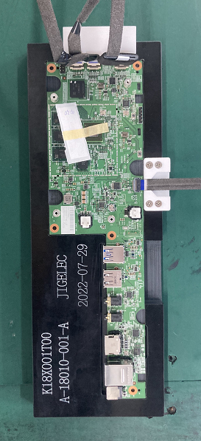
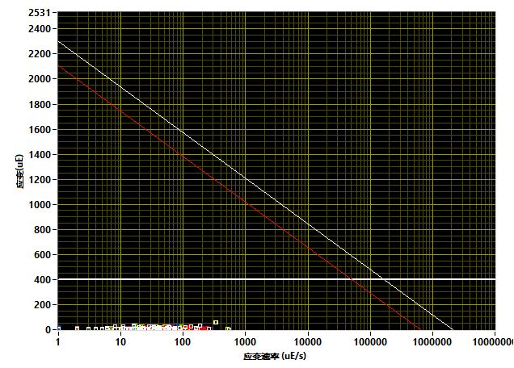
Station : FFC Cable Assembly
Type 3 : At FFC Cable Assembly
Max Diagonal Value(uE):
IPC9704表格
编号 | 元件名 | 位置 | 应变最大值(uE) | Limit (uE) | 结果
No.1 | SENSOR 2 | U1 | -16 | 400 | Pass
No.2 | SENSOR 1 | U1 | -3 | 400 | Pass
Result: Measured values are within the standard of control-> PASS

Slide 9
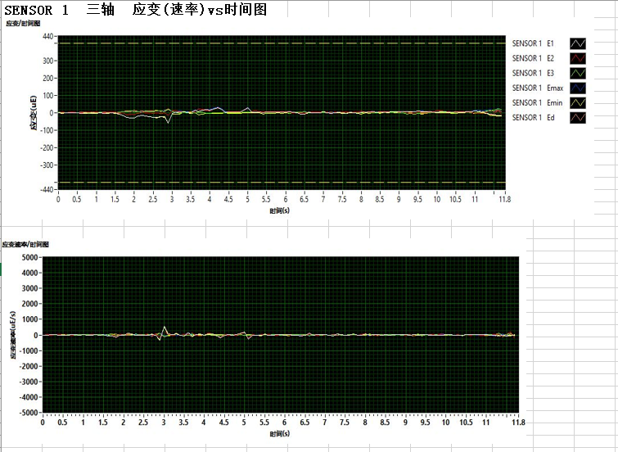
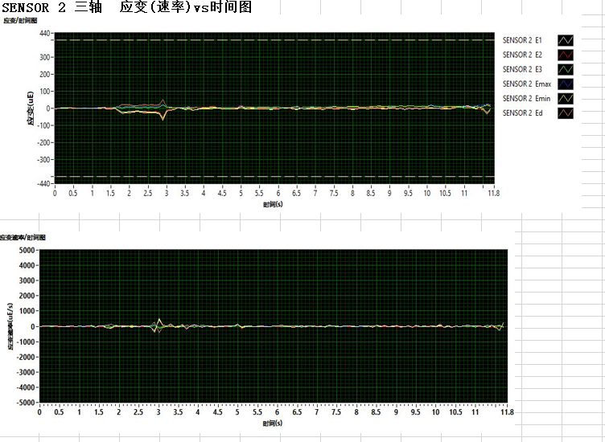
Station : FFC Cable Assembly
Type 3 : At FFC Cable Assembly
Image Sensor 1
Image Sensor 2

Slide 10
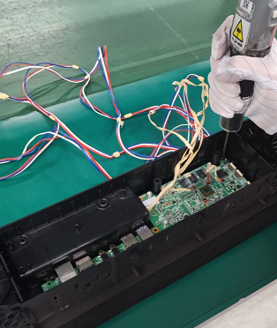
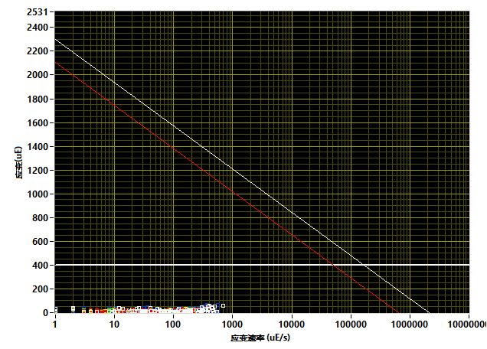
Station : Screw PCBA &Heatsink
Type 4 : At Screw PCBA &Heatsink
Max Diagonal Value(uE):
IPC9704表格
编号 | 元件名 | 位置 | 应变最大值(uE) | Limit (uE) | 结果
No.1 | SENSOR 1 | U1 | 14 | 400 | Pass
No.2 | SENSOR 2 | U1 | 56 | 400 | Pass
Result: Measured values are within the standard of control-> PASS

Slide 11
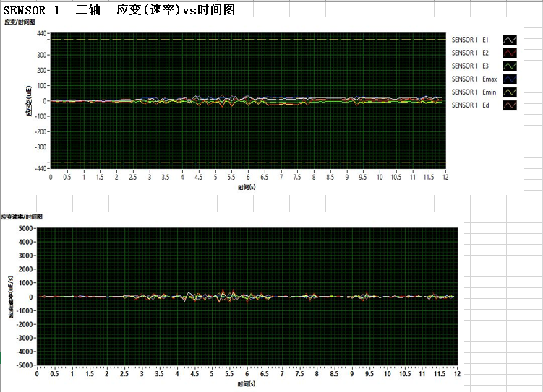
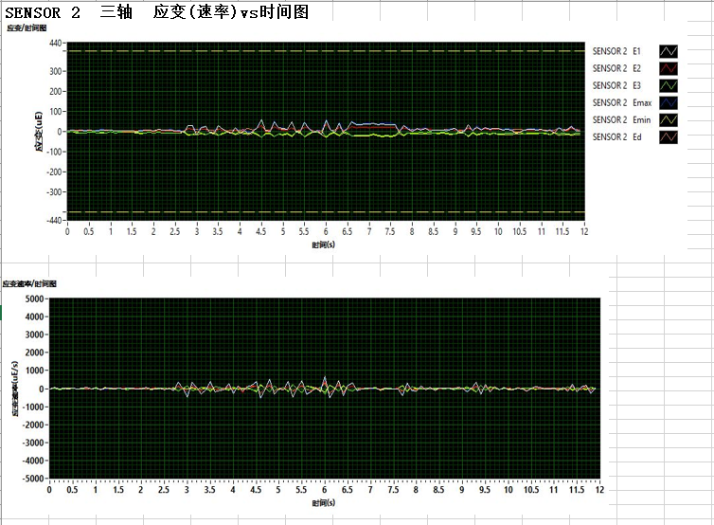
Station : Screw PCBA &Heatsink
Type 4 : At Screw PCBA &Heatsink
Image Sensor 1
Image Sensor 2

Slide 12
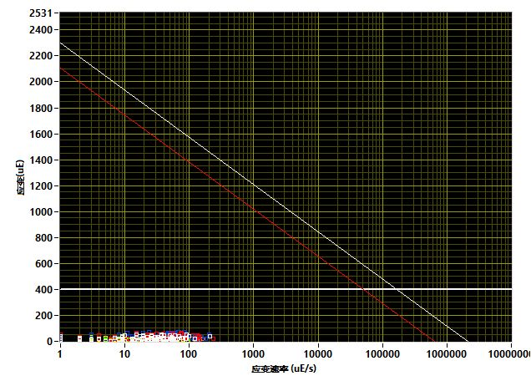
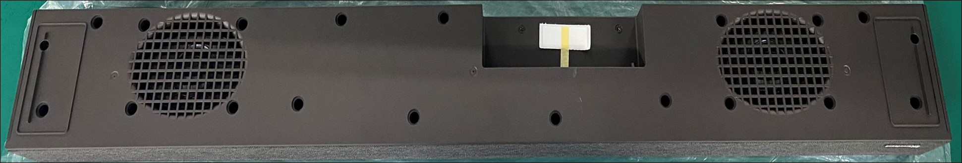
Station : Screw Housing
Type 5 : At Screw Housing
Max Diagonal Value(uE):
IPC9704表格
编号 | 元件名 | 位置 | 应变最大值(uE) | Limit (uE) | 结果
No.1 | SENSOR 1 | U1 | 49 | 400 | Pass
No.2 | SENSOR 2 | U1 | 54 | 400 | Pass
Result: Measured values are within the standard of control-> PASS

Slide 13
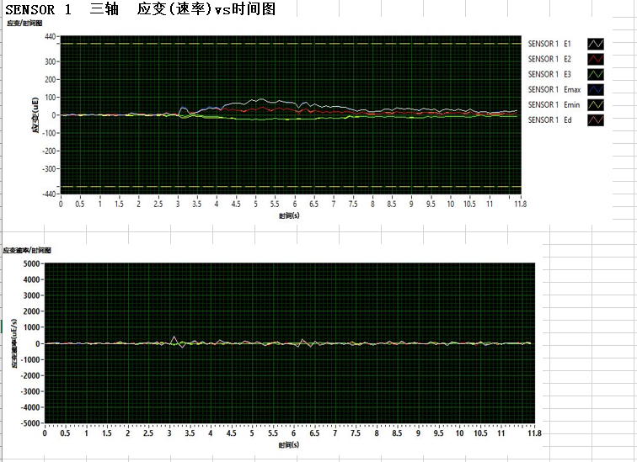
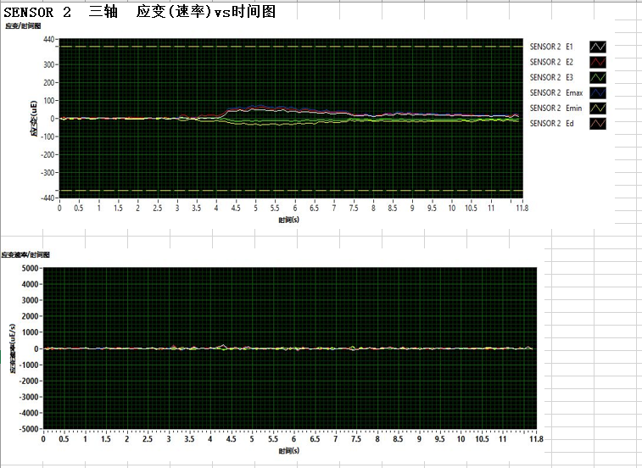
Station : Screw Housing
Type 5 : At Screw Housing
Image Sensor 1
Image Sensor 2

Slide 14
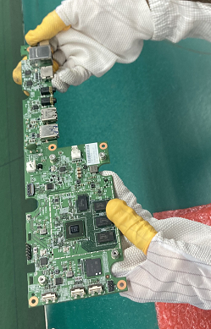
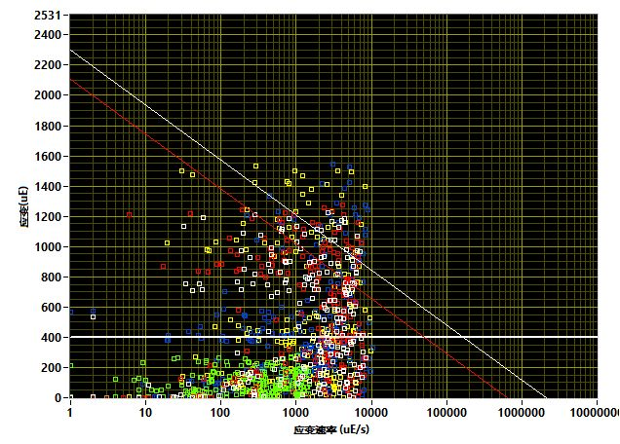
Especially Testing item : Drop or bending the PCBA to deform
Max Diagonal Value(uE):
IPC9704表格
编号 | 元件名 | 位置 | 应变最大值(uE) | Limit (uE) | 结果
No.1 | sensor A | U1 | 2180 | 400 | Fail
No.2 | sensor B | U1 | 1527 | 400 | Fail
Note: Simulate the impact of the force to deform the PCBA or test the PCBA to drop which has the risk of cracking the BGA U1 location and the product cannot test normally.
Result: Measured values are over specifications> Fail

Slide 15
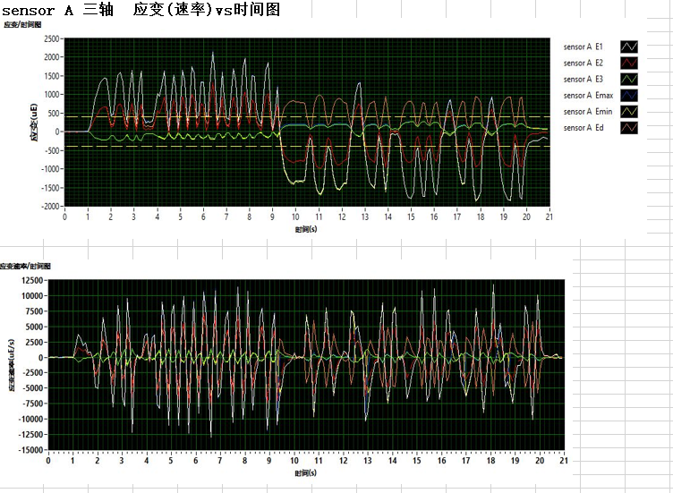
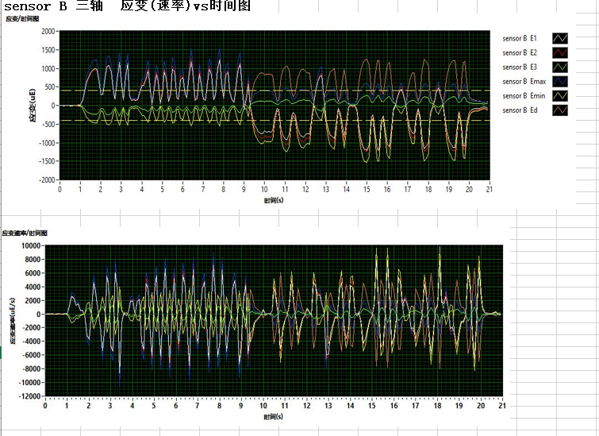
Especially Testing item : Drop or bending the PCBA to deform
Image Sensor 1
Image Sensor 2
Result: Measured values are over specifications> Fail

Slide 16
K18X001.00 Strain gauge report
Result Strain Gauge Test Stations :
At PCBA Trolley :Pass
At test BT :Pass
FFC Cable Assembly :Pass
Screw PCBA &Heatsink :Pass
Screw Housing :Pass
Conclusion: PCBA transfer and assembly follow normal process does not find risk of BGA U1 being cracked

